Slide 1
CSE 170 Technical Teamwork Fall 2024
Making you awesome – so you can be a better teammate.

Slide 2
Opening Prayer

Slide 3


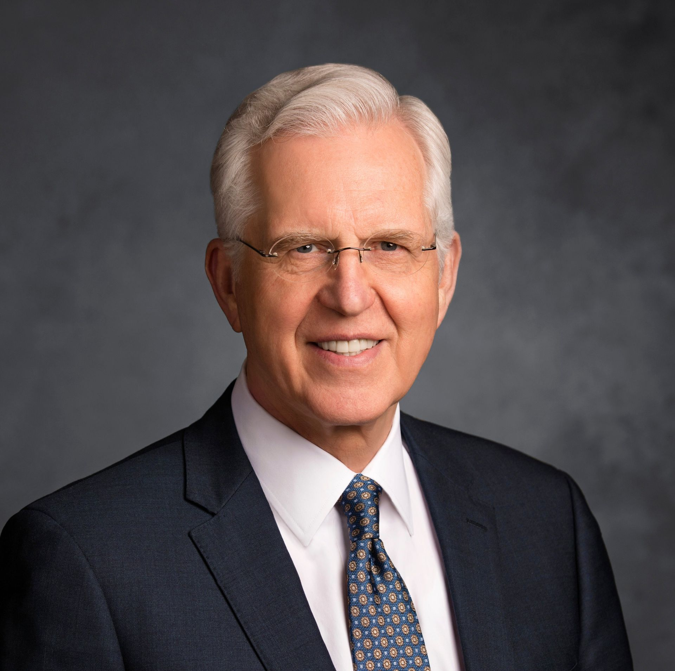

Self-Discipline – Spiritual Thought
“Moral discipline is the consistent exercise of agency to choose the right because it is right, even when it is hard. ”
Elder D. Todd Christofferson
October 2009 General Conference.

Slide 4
Agenda
Self-Management
Assignments
Review assignments and due dates
Initial the roll
Habit formation
Positive Outlook
Goal Setting
Vision Boards

Slide 5
Assignments
U02 Prove: Activity Log
Keep track of your daily activities for two days, then report your findings.
If using the template, don’t worry about recording energy levels, etc.
Due Saturday
U02 Prove: Vision Board
Make a collage of your goals and aspirations and explain how self-management will help you get there.
Due Saturday

Slide 6


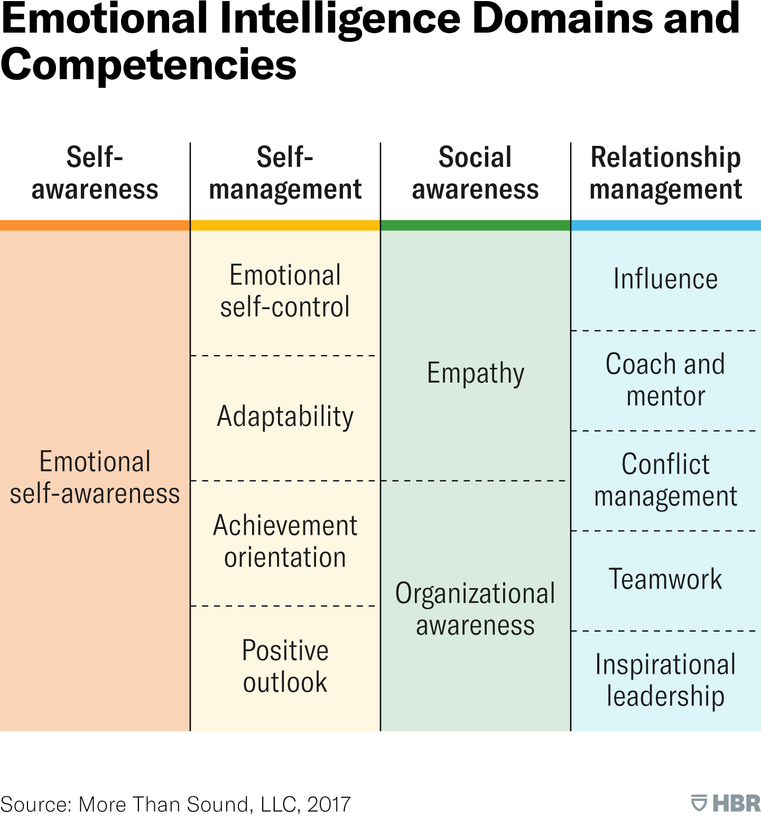

Emotional Intelligence

Slide 7
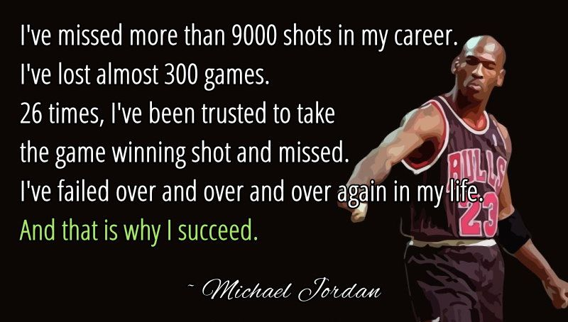
Failure Leads To Success

Slide 8

Wer Nicht Wagt, Gewinnt Nicht
(Nothing Ventured, Nothing Gained)

Slide 9
Positive Outlook: Benefits
Increases resilience
Enhances problem-solving skills
Boosts confidence
Increases motivation
Attracts positivity
Source: https://www.linkedin.com/pulse/how-positive-outlook-life-helps-you-successful-shubhra-shrivastava

Slide 10
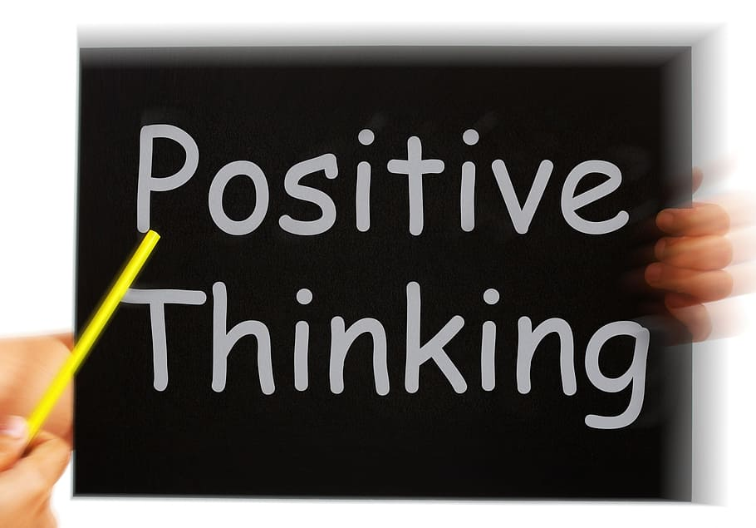
Group Discussion
Share an example of how you have kept a positive outlook in the face of failure or other difficulty.
or
Share an example of how you would like to increase positivity in your life.

Slide 11
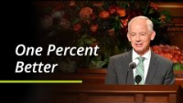
The Aggregation of Marginal Gains

Slide 12
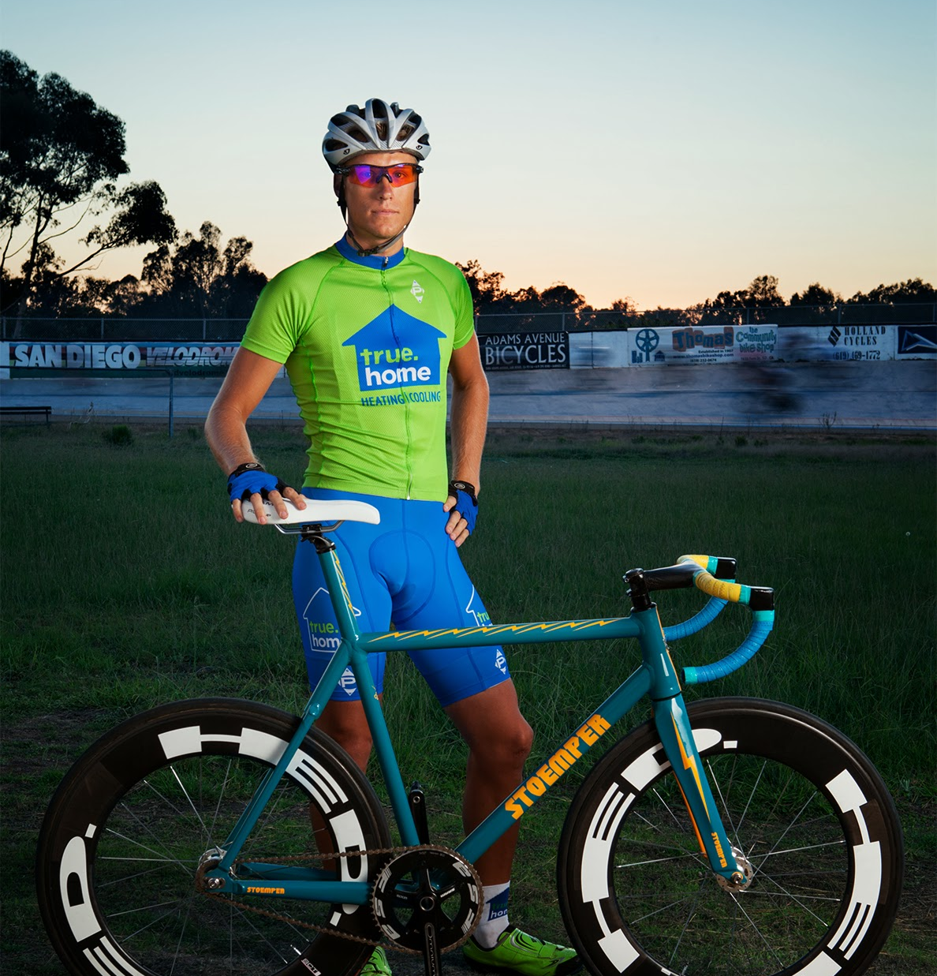
1% Better – The Results
5 years later in the 2008 Olympic Games, British cyclists took 60% of all medals.
That same year Bradly Wiggins became the first British national to win the Tour de France.
From 2007 – 2017 British cyclists won 178 championships, 66 Olympic medals and 5 Tour de France victories.
In what ways does the “aggregation of marginal gains” strategy help us?
How is this strategy better than making sudden drastic changes?
How does “daily repentance” help us become 1% better?
This Photo by Unknown Author is licensed under CC BY-SA
Source: Atomic Habits – James Clear

Slide 13
Forming Better Habits
Make it Obvious
Use cues and location to perform automated actions
Make it Attractive
Make your habit something you WANT to do
Make it Easy
Repetition and marginal gains make things easy
Make it Satisfying
Tie rewards to the performance of the positive habit
Source: Atomic Habits – James Clear

Slide 14
Eliminating Bad Habits
Make it Invisible
Remove yourself from situations where you normally do the bad habit
Make it Unattractive
Find ways to make your bad habit unappealing so you loathe it
Make it Difficult
Require unreasonable effort to do your bad habit.
Make it Unsatisfying
Find a way to make continuation of your habit unfulfilling. Use an accountability partner.
Source: Atomic Habits – James Clear

Slide 15
Group Discussion - Habits
GOOD HABITS
BAD HABITS
Make it Obvious
Make it Attractive
Make it Easy
Make it Satisfying
Make it Invisible
Make it Unattractive
Make it Difficult
Make it Unsatisfying

Slide 16

Making a Vision Board
A vision board is a visual reminder of your goals.
It’s a collage of photos, mementos, etc. that point you toward what you want to achieve.
Vision boards can be physical or digital.
This is my vision board for 2024.

Slide 17
Using Canva for a Digital Vision Board
Create an account on Canva (it’s free)
I’ll show you how to customize one of the boards here:
https://www.canva.com/p/templates/EAFN7sqNR4w-white-and-beige-collage-vision-board-instagram-story/
Your board needs to include the following categories:
Work and Career
Lifestyle and Personal
Relationships and Family
Spiritual

Slide 18
Submitting your Vision Board
If you don’t want to use Canva, you can use other tools like Adobe Illustrator or online photo collage tools.
You can also make a physical vision board and take a picture of it.
Make sure you include in the submission comments how you can use the self-management techniques we’ve discussed in class to help you with your goals.

